Slide 1
Computer Science and Artificial Intelligence

Slide 2
Content
Intelligence and Machines
Perception
Reasoning
Additional Areas of Research
Artificial Neural Networks
Robotics
Considering the Consequences
About Computer Science Department

Slide 3
What is AI?
Artificial intelligence is the field of computer science that seeks to build autonomous machines
machines that can carry out complex tasks without human intervention.
machines be able to perceive and reason.
The field of artificial intelligence is quite large and merges with other subjects such as psychology, neurology, mathematics, linguistics, and electrical and mechanical engineering.

Slide 4
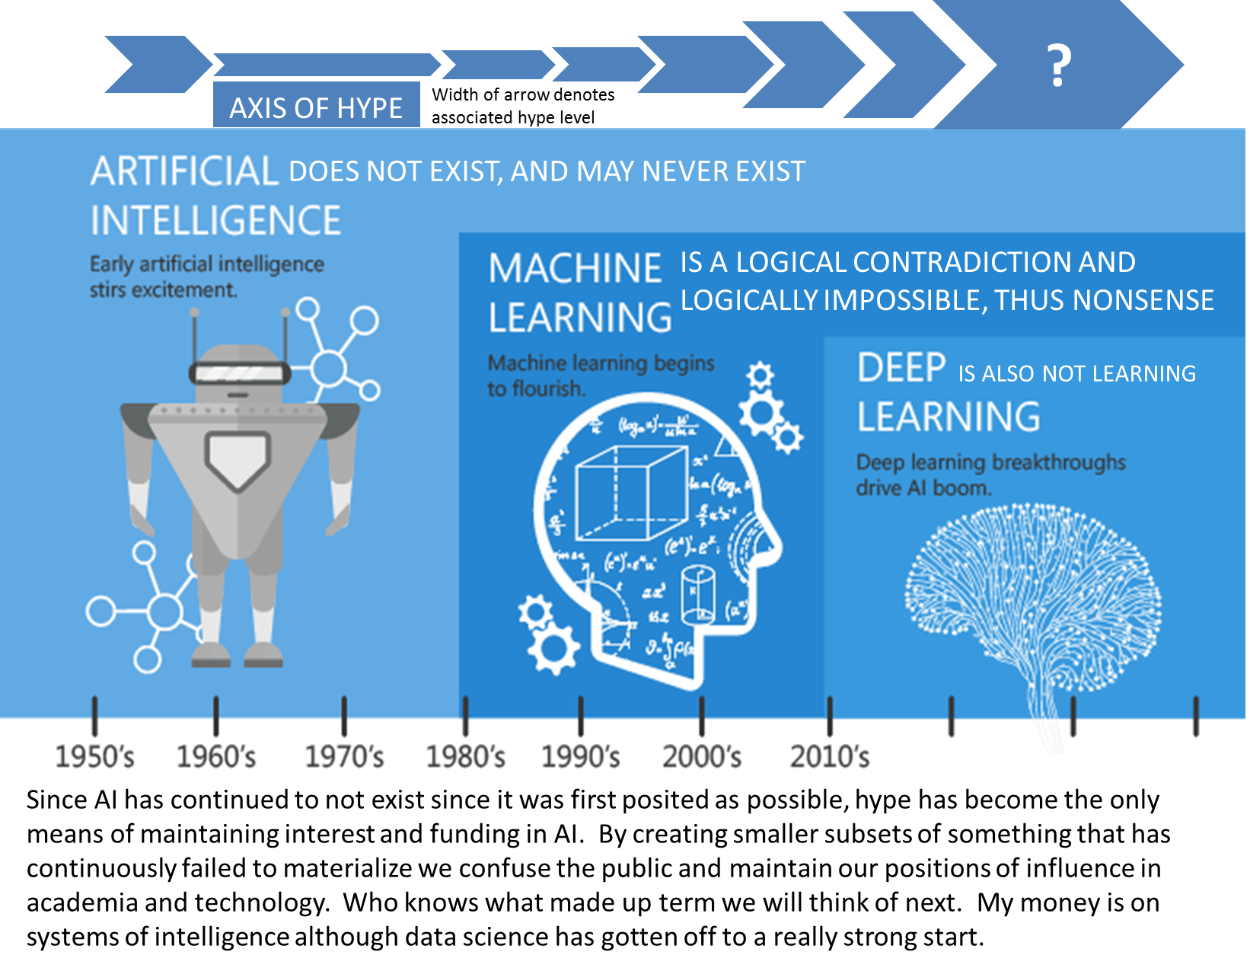
What is AI?

Slide 5
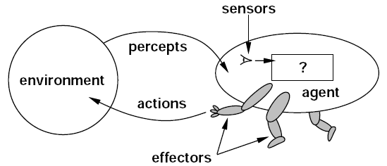
Intelligent Agents
Agent: A “device” that responds to stimuli from its environment
Sensors (microphones, cameras, range sensors, and air or soil sampling devices, …)
Actuators (wheels, legs, wings, grippers, and speech synthesizers,…)
Much of the research in artificial intelligence can be viewed in the context of building agents that behave intelligently
Notes:
“An agent is anything that can be viewed as perceiving its environment through sensors and acting upon that environment through effectors" - (Artificial Intelligence: A Modern Approach by Stuart Russell and Peter Novig)
The actions of the agent’s actuators must be rational responses to the data received though its sensors.

Slide 6
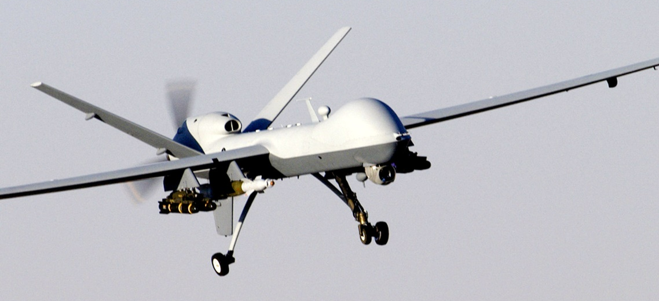
Intelligent Agents
An agent as an individual machine such as a robot.
However, an agent may take other forms such as an autonomous airplane, a character in an interactive video game, or a process communicating with other processes over the Internet (perhaps as a client, a server, or a peer).
Unmanned aerial vehicle

Slide 7
Levels of Intelligent Behavior
Reflex: actions are predetermined responses to the input data
More intelligent behavior requires knowledge of the environment and involves such activities as:
Goal seeking (such as winning a game of chess or maneuvering through a crowded passageway)
Learning (an agent’s responses improve over time)
Notes:
For example, we might empower an agent with knowledge of its environment and require that the agent adjust its actions accordingly. The process of throwing a baseball is largely a reflex action but determining how and where to throw the ball requires knowledge of the current environment. For example, we might empower an agent with knowledge of its environment and require that the agent adjust its actions accordingly. The process of throwing a baseball is largely a reflex action but determining how and where to throw the ball requires knowledge of the current environment.

Slide 8
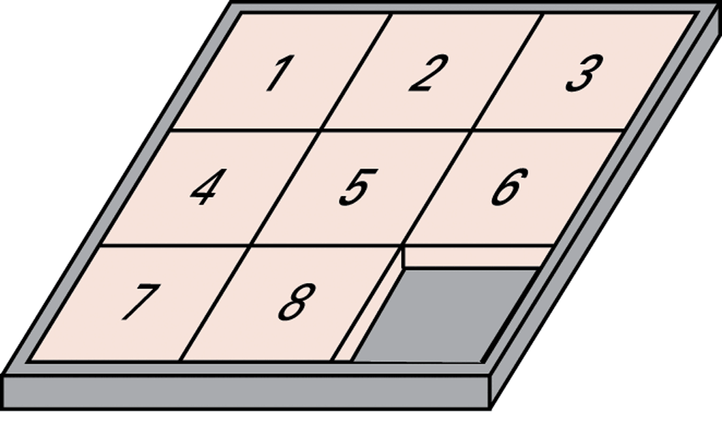
The eight-puzzle in its solved configuration

Slide 9
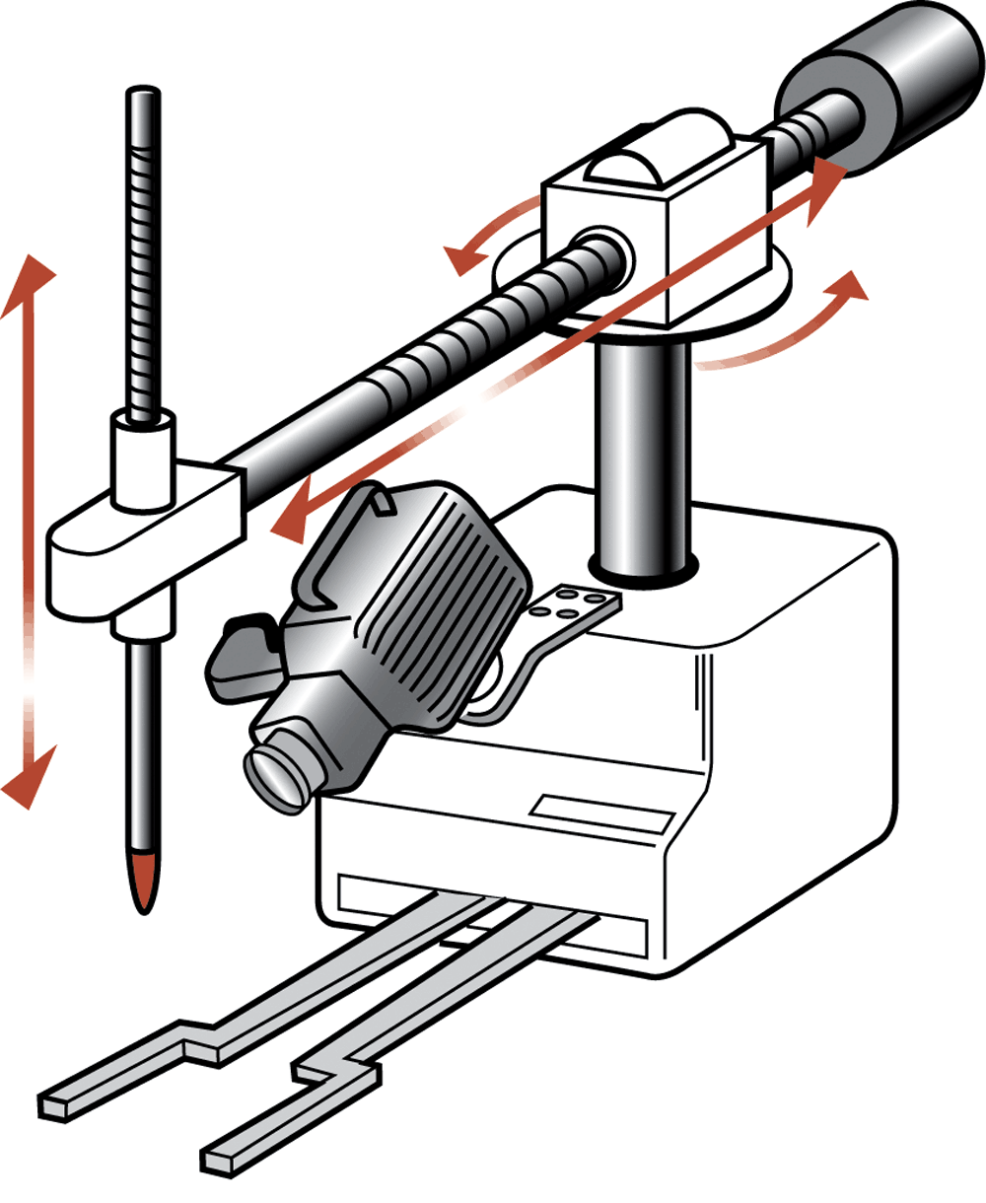
Our puzzle-solving machine

Slide 10
Approaches to Research in Artificial Intelligence
Engineering track: develop systems that exhibit intelligent behavior.
Performance oriented (produce a product that meets certain performance goals)
Theoretical track: develop a computational understanding of animal—especially human—intelligence.
Simulation oriented (expand our understanding of intelligence)

Slide 11
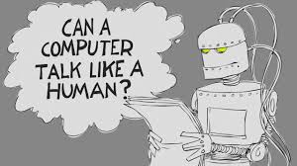
Turing Test
Turing test (proposed by Alan Turing in 1950) has served as a benchmark in measuring progress in the field of artificial intelligence.
https://www.youtube.com/watch?v=3wLqsRLvV-c

Slide 12

Turing Test
Test setup: Human interrogator communicates with test subject by typewriter.
Test: Can the human interrogator distinguish whether the test subject is human or machine?

Slide 13
Content
Intelligence and Machines
Perception
Reasoning
Additional Areas of Research
Artificial Neural Networks
Robotics
Considering the Consequences
About Computer Science Department

Slide 14
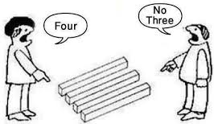
Perception
To respond intelligently to the input from its sensors, an agent must be able to understand that input (perceive).
Two areas of research in perception that have proven to be especially challenging:
understanding images and language.

Slide 15
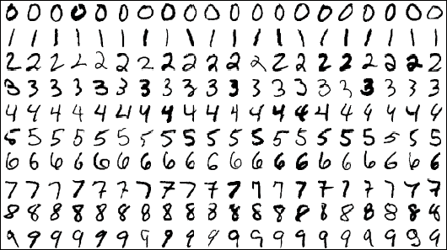
Techniques for Understanding Images
Template matching
Image processing (identifying characteristics of the image)
edge enhancement
region finding
smoothing
Image analysis (the process of understanding what these characteristics mean)

Slide 16
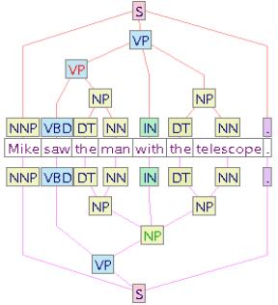
Language Processing
Syntactic Analysis
Semantic Analysis
Contextual Analysis

Slide 17
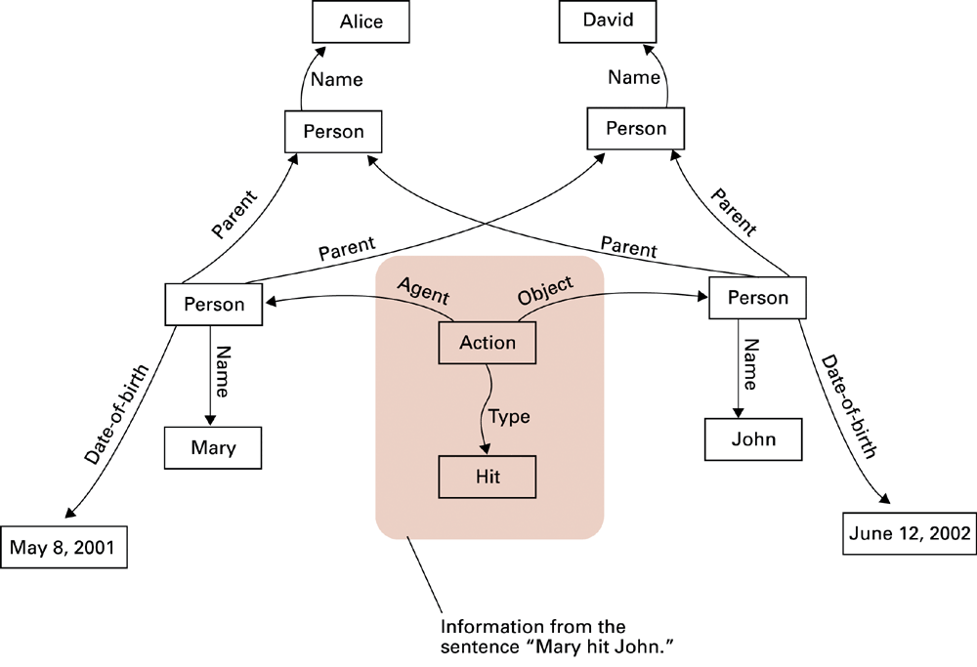
A semantic net

Slide 18
Content
Intelligence and Machines
Perception
Reasoning
Additional Areas of Research
Artificial Neural Networks
Robotics
Considering the Consequences
About Computer Science Department

Slide 19
Reasoning
Reasoning is the act of deriving a conclusion from certain premises using a given methodology.
Reasoning is a process of thinking.
Reasoning is logically arguing.
Reasoning is drawing inference.
It must figure out what it needs to know from what it already knows

Slide 20
Reasoning Example
If we know :
Robins are birds, and
All birds have wings
Then if we ask:
Do robins have wings?
To answer this question - some reasoning must go.

Slide 21
Uncertainty in Reasoning
The world is an uncertain place; often the Knowledge is imperfect (Incomplete, Inconsistent, Changing) which causes uncertainty.
Therefore reasoning must be able to operate under uncertainty.
AI systems must have ability to reason under conditions of uncertainty.

Slide 22
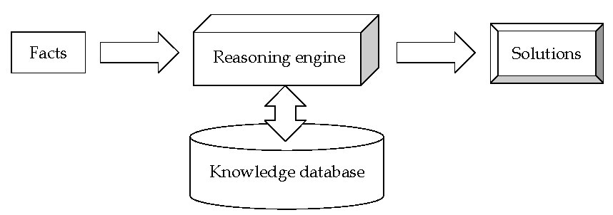
Reasoning under uncertainty
Many reasoning systems provide capabilities for reasoning under uncertainty.
This is important when building situated reasoning agents which must deal with uncertain representations of the world.

Slide 23
Reasoning Systems
Production systems
Theorem provers
Deductive retrieval systems
Semantic networks
…

Slide 24
Production Systems
1. Collection of states
Start (or initial) state
Goal state (or states)
2. Collection of productions: rules or moves
A production is an operation that can be performed in the application environment to move from one state to another
Each production may have preconditions
3. Control system: decides which production to apply next

Slide 25
Reasoning by Searching
State Graph: All states and productions
Search Tree: A record of state transitions explored while searching for a goal state
Breadth-first search
Depth-first search

Slide 26
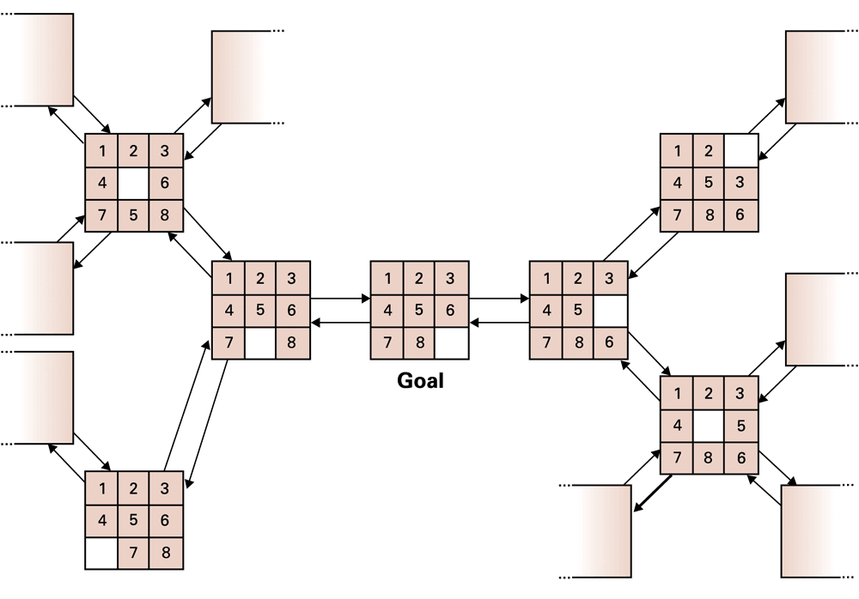
A small portion of the eight-puzzle’s state graph

Slide 27
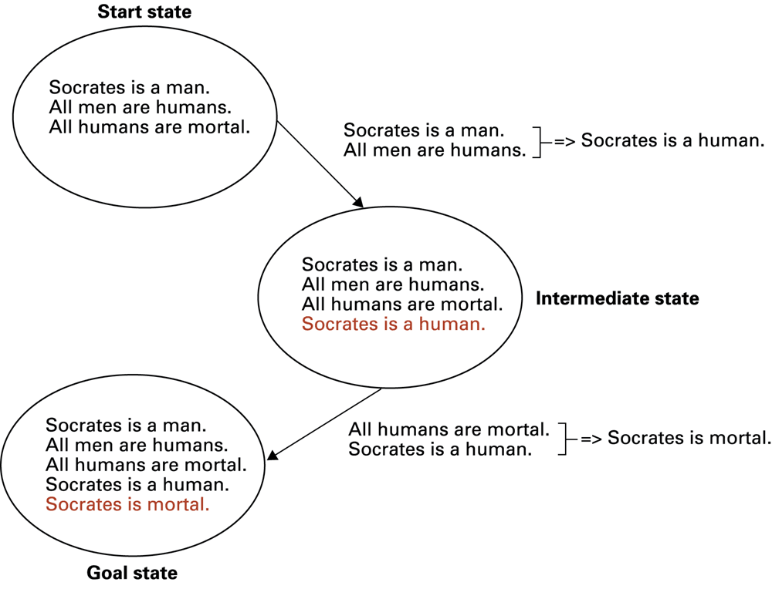
Deductive reasoning in the context of a production system

Slide 28
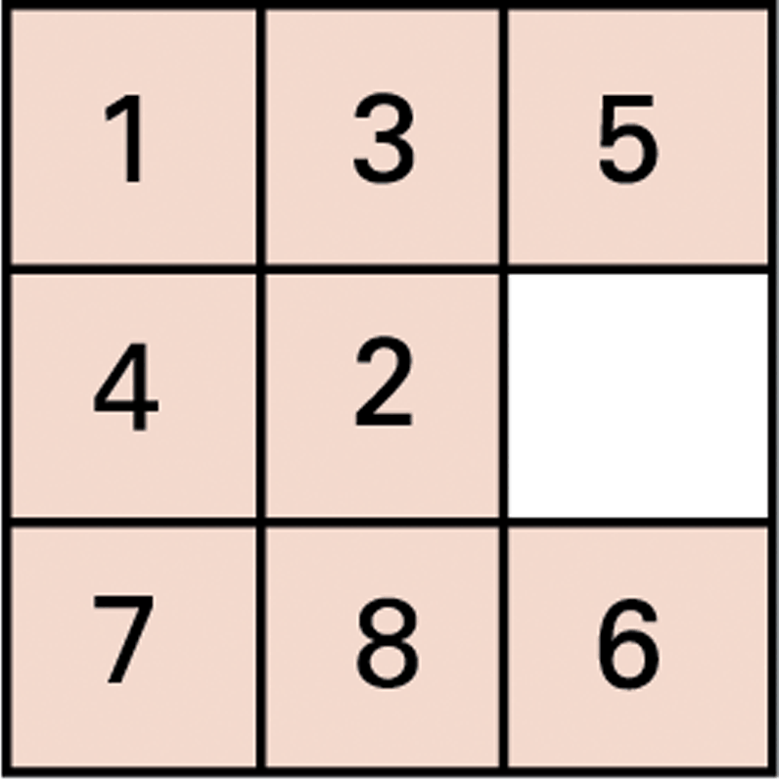
An unsolved eight-puzzle

Slide 29
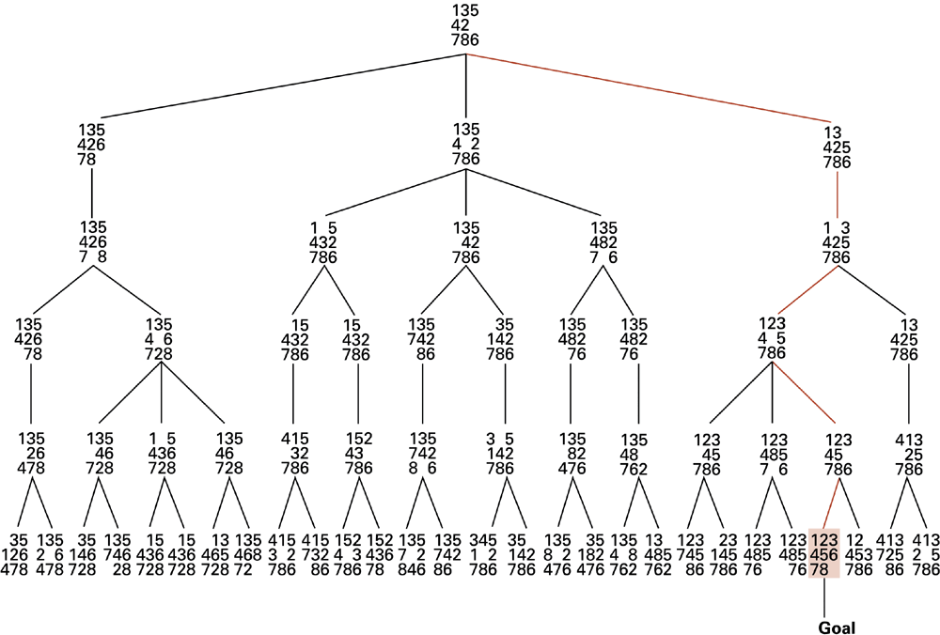
A sample search tree

Slide 30
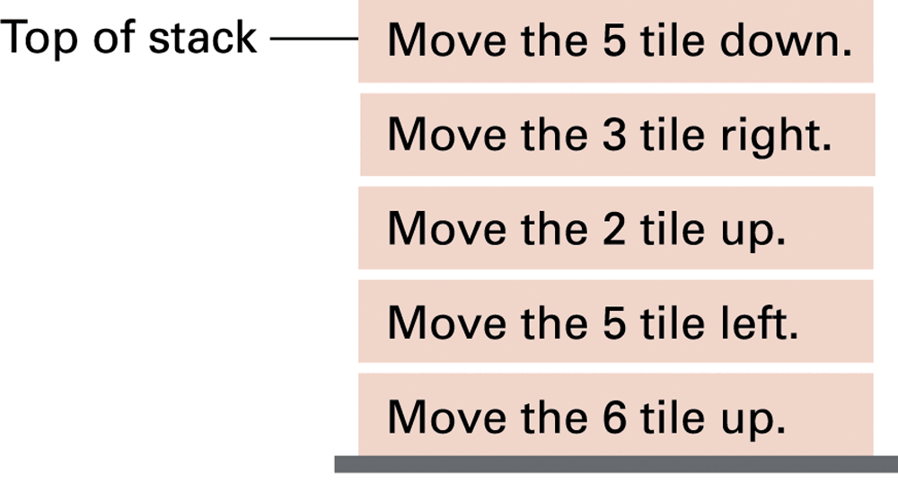
Productions stacked for later execution

Slide 31
Heuristic Strategies
Heuristic: A “rule of thumb” for making decisions
Requirements for good heuristics
Must be easier to compute than a complete solution
Must provide a reasonable estimate of proximity to a goal

Slide 32
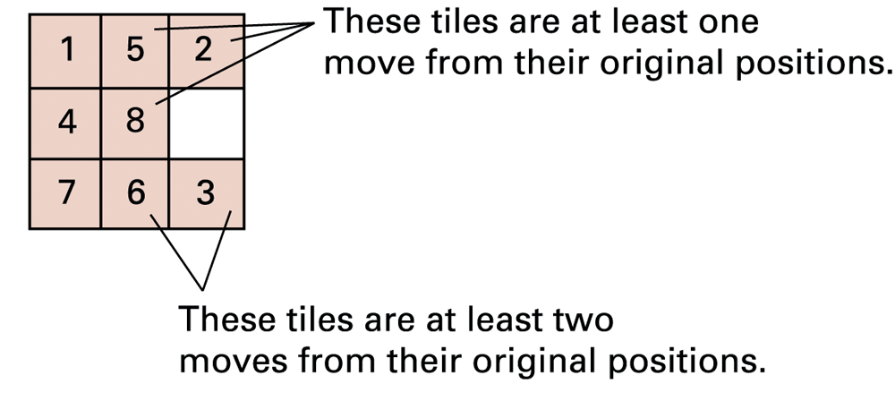
An unsolved eight-puzzle

Slide 33
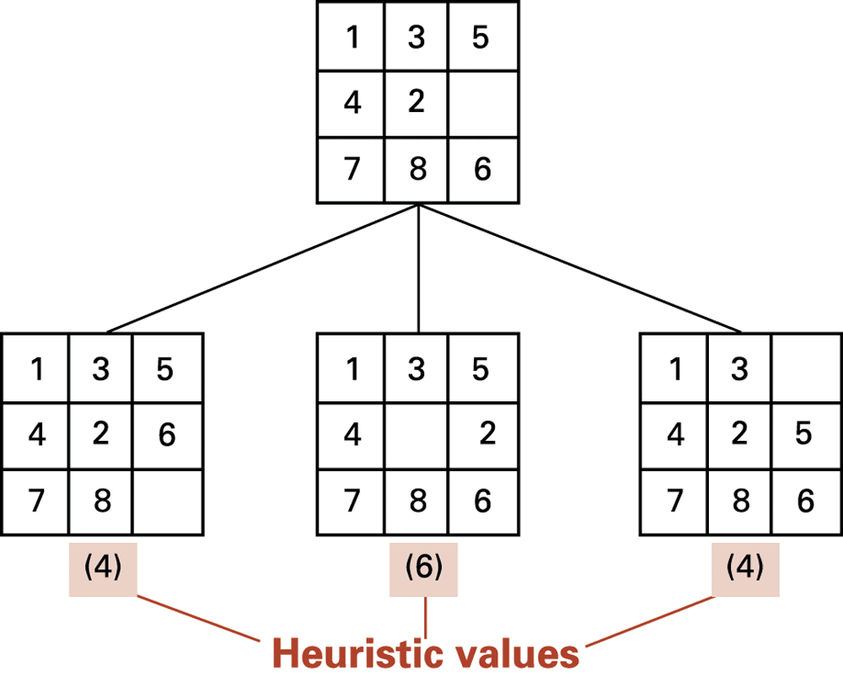
The beginnings of heuristic search

Slide 34
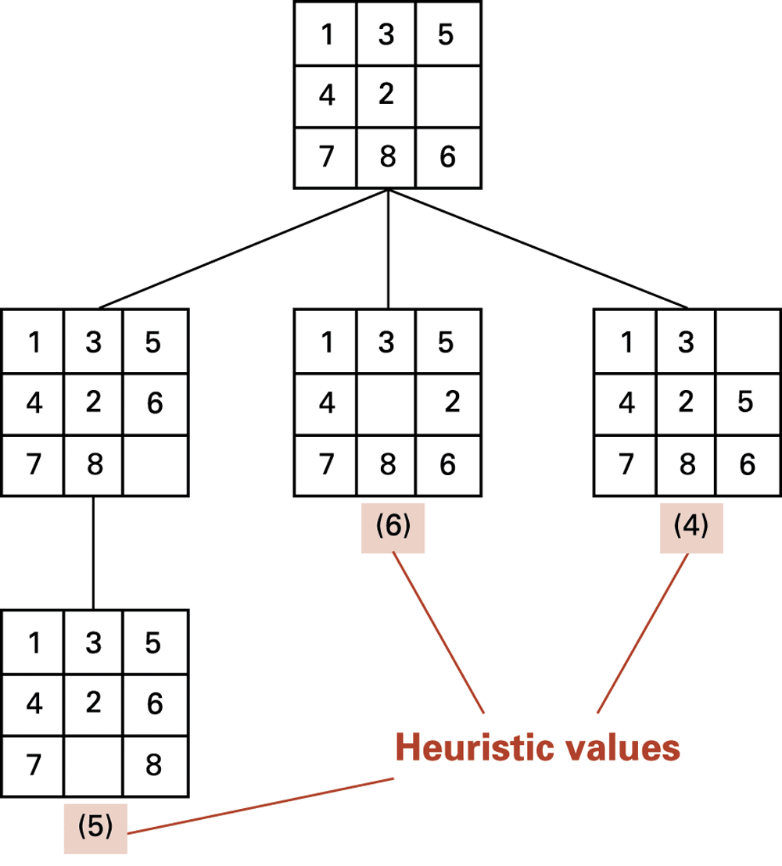
The search tree after two passes

Slide 35
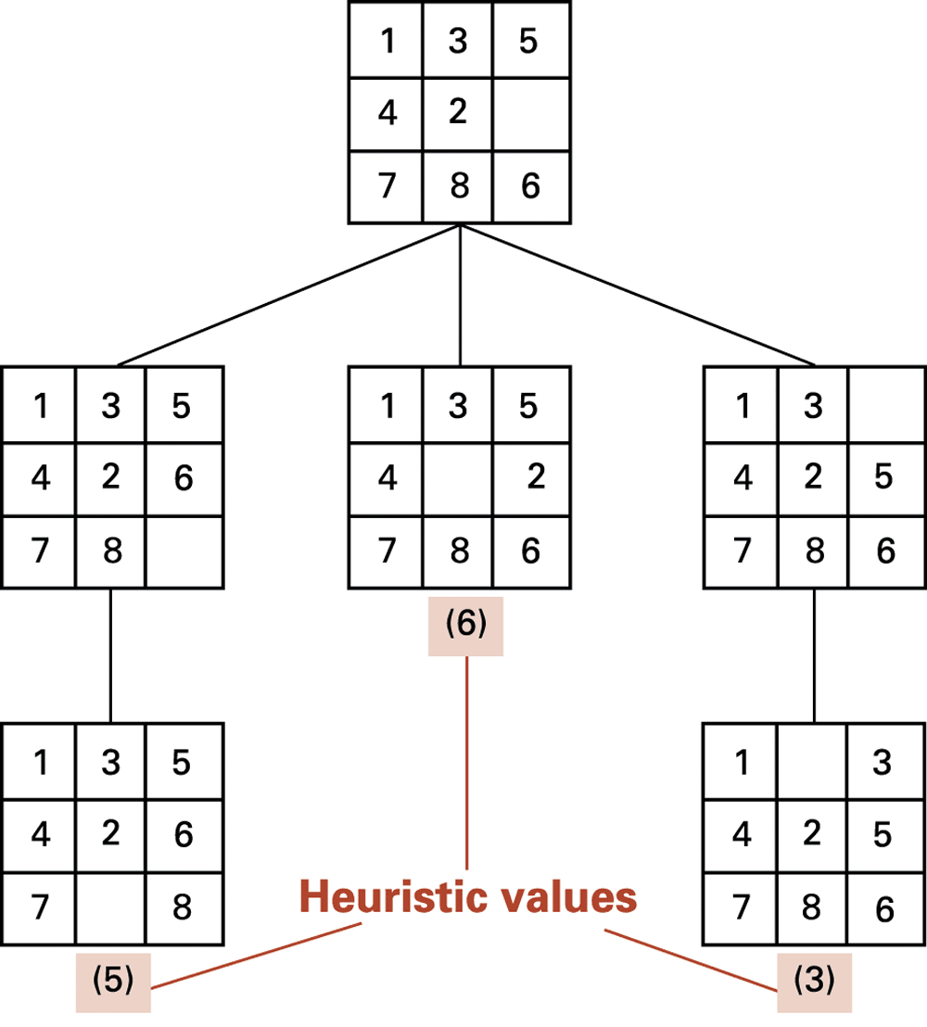
The search tree after three passes

Slide 36
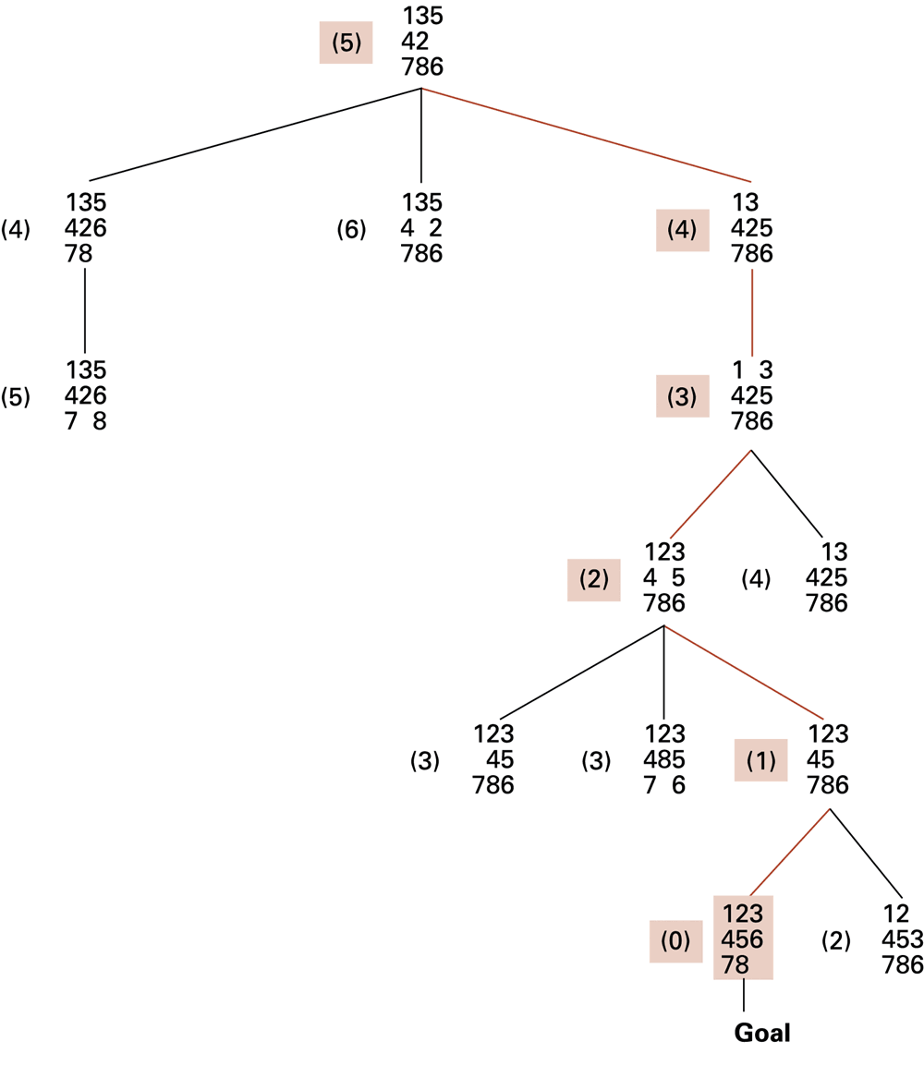

Slide 37
Content
Intelligence and Machines
Perception
Reasoning
Additional Areas of Research
Artificial Neural Networks
Robotics
Considering the Consequences
About Computer Science Department

Slide 38
Handling Real-World Knowledge
Representation and storage
Accessing relevant information
Meta-Reasoning (reasoning about reasoning)
Closed-World Assumption
Frame problem
Keeping stored knowledge up to date in a changing environment

Slide 39
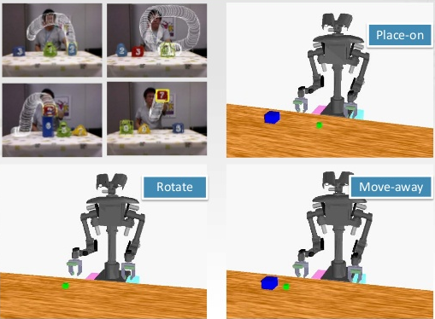
Learning
Imitation
directly demonstrates the steps in a task and the computer simply records the steps.

Slide 40
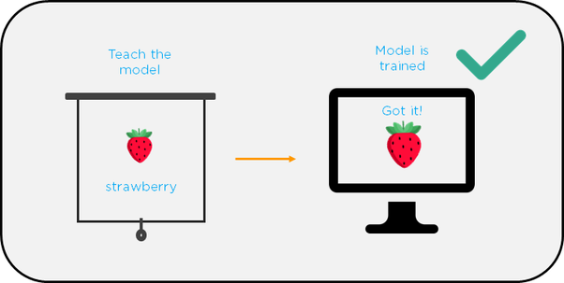
Learning
Supervised learning
Task of learning a function that maps an input to an output based on example input-output pairs.

Slide 41
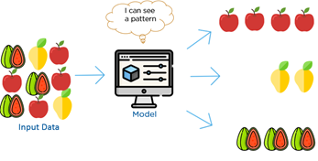
Learning
Unsupervised Learning
learns from test data that has not been labeled, classified or categorized
Instead of responding to feedback, unsupervised learning identifies commonalities in the data and reacts based on the presence or absence of such commonalities in each new piece of data.

Slide 42

Learning
Reinforcement learning
refers to goal-oriented algorithms, which learn how to take actions in an environment so as to maximize some notion of cumulative reward.

Slide 43
Genetic Algorithms
There are some problems that are too complex to be solved such as:
execution exceeds available memory or
cannot be completed within a reasonable amount of time.
A solution can sometimes be discovered through an evolutionary process involving many generations of trial solutions.
This strategy is the foundation for what is called genetic algorithms.

Slide 44
Genetic Algorithms
Begins by generating a random pool of trial solutions:
Each solution is a chromosome
Each component of a chromosome is a gene
Repeatedly generate new pools
Each new chromosome is an offspring of two parents from the previous pool
Probabilistic preference used to select parents
Each offspring is a combination of the parent’s genes

Slide 45
Content
Intelligence and Machines
Perception
Reasoning
Additional Areas of Research
Artificial Neural Networks
Robotics
Considering the Consequences
About Computer Science Department

Slide 46
Artificial Neural Networks
Many researchers are turning to approaches that leverage phenomena observed in nature.
One such approach is genetic algorithms presented in the previous section.
Another approach is the artificial neural network (human mind)

Slide 47
Artificial Neural Networks
Artificial Neuron
Each input is multiplied by a weighting factor.
Output is 1 if sum of weighted inputs exceeds the threshold value; 0 otherwise.
Network is programmed by adjusting weights using feedback from examples.

Slide 48
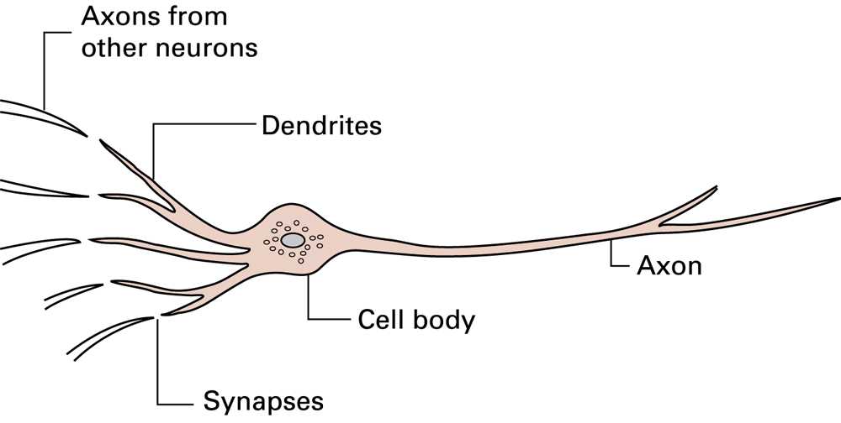
A neuron in a living biological system

Slide 49
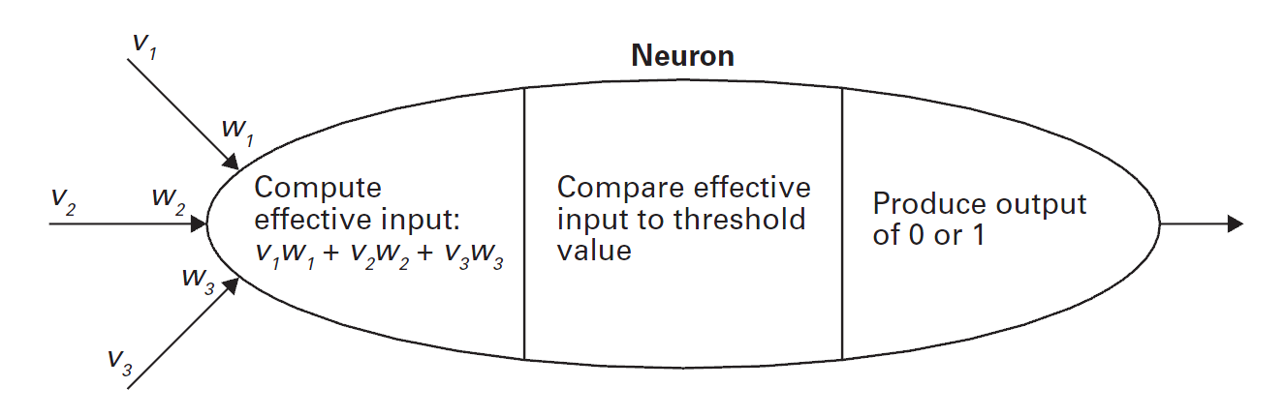
The activities within a processing unit

Slide 50
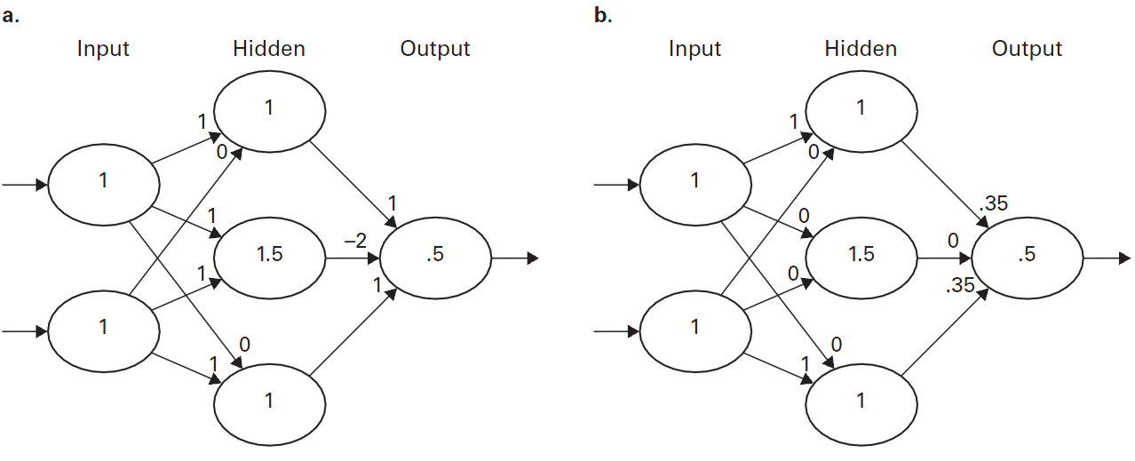
A neural network with two different programs

Slide 51
Content
Intelligence and Machines
Perception
Reasoning
Additional Areas of Research
Artificial Neural Networks
Robotics
Considering the Consequences
About Computer Science Department

Slide 52
Robotics
Truly autonomous robots require progress in perception and reasoning.
To interact with the world, robots need mechanisms to manipulate objects and to move about.
In the early days of robotics, the field was closely allied with the development of manipulators, most often mechanical arms with elbows, wrists, and hands or tools.

Slide 53
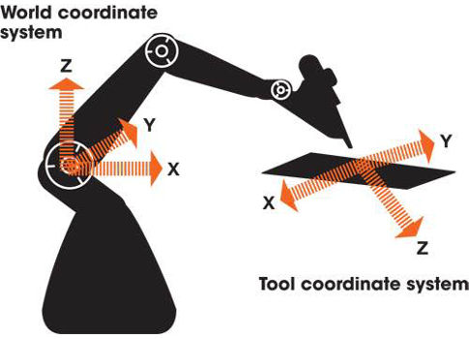
Robotics
Research dealt not only with how such devices could be maneuvered but also with how knowledge of their location and orientation could be maintained and applied.

Slide 54
Evolutionary robotics
Evolutionary robotics (ER) is a methodology that uses evolutionary computation to develop controllers and/or hardware for autonomous robots.
Algorithms in ER frequently operate on populations of candidate controllers, initially selected from some distribution.
This population is then repeatedly modified according to a fitness function.

Slide 55
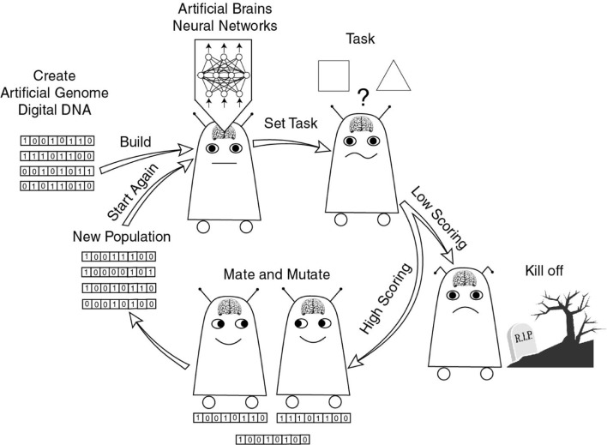
Evolutionary robotics

Slide 56
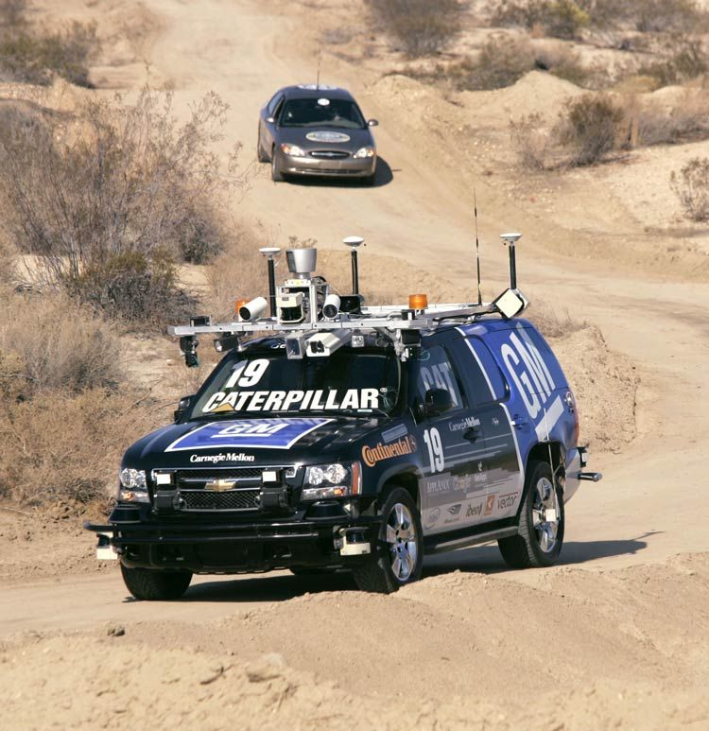
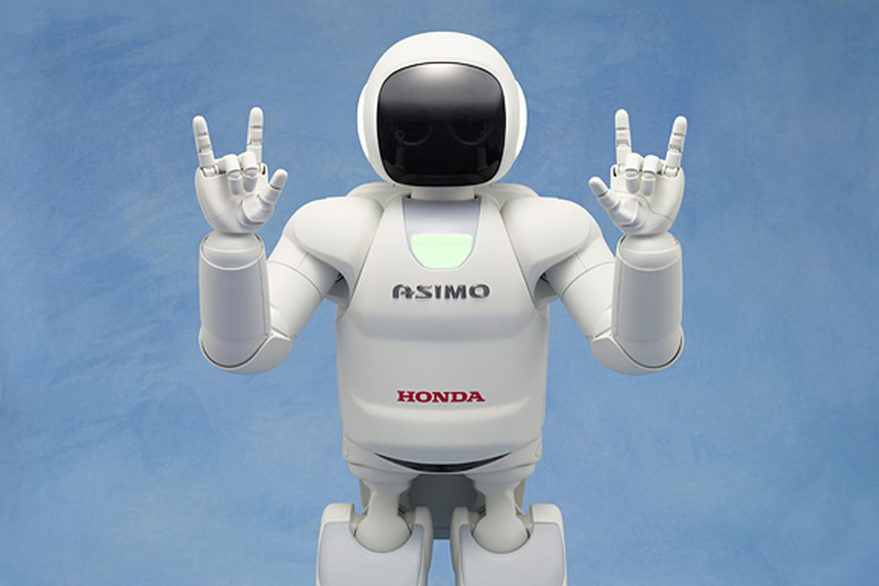
Evolutionary robotics
asimo
Tartan Racing

Slide 57
Content
Intelligence and Machines
Perception
Reasoning
Additional Areas of Research
Artificial Neural Networks
Robotics
Considering the Consequences
About Computer Science Department

Slide 58
Issues Raised by Artificial Intelligence
Discuss about:
When should a computer’s decision be trusted over a human’s?
If a computer can do a job better than a human, when should a human do the job anyway?
What would be the social impact if computer “intelligence” surpasses that of many humans?

Slide 59
Content
Intelligence and Machines
Perception
Reasoning
Additional Areas of Research
Artificial Neural Networks
Robotics
Considering the Consequences
About Computer Science Department

Slide 60

Department of Computer Science
Since 2006
Room I81
Email: khmt@fit.hcmus.edu.vn
Head: Prof. Le Hoai Bac
Vice Head: Msc. Le Ngoc Thanh

Slide 61
CS Educational Objectives
Provide students with knowledge in soft computing, data mining, biometrics, machine learning and pattern recognition, parallel programming, data hiding and some other field of computer science.
Researching skills

Slide 62
Computer Science Sub Majors
Computer Science
Knowledge Engineering
Computer Graphics

